Slide 1
Conflict ,Resolution of Conflict and Peace Keeping
(as a part of International Security ,Diplomacy and Conflict Resolution)
Dr. H.Vageeshan,
Assistant Professor in Political Science
NALSAR University of Law
vagpolitics@gmail.com , vagpolitcs@nalsar.ac.in

Slide 2
What will we try to understand?
The meaning of peace in ‘narrow’ and ‘broad’ sense .
Understanding Conflict ,Its sources and impact
War -Conflict where use of force is legitimized
The Humanitarian law
The possibility and limits of Use of Force .
Peaceful ways of settlement of disputes .
The Peace keeping International Public and Private institutions ( IGOs and NGOs).

Slide 3
Clash of Interests and Conflicts
Territorial Interests ( Geo Strategic ).
Natural Resources.
Serious Ideological Differences amounting to rivalry.
Economic and Business interests.
Culture as a source of conflict

Slide 4
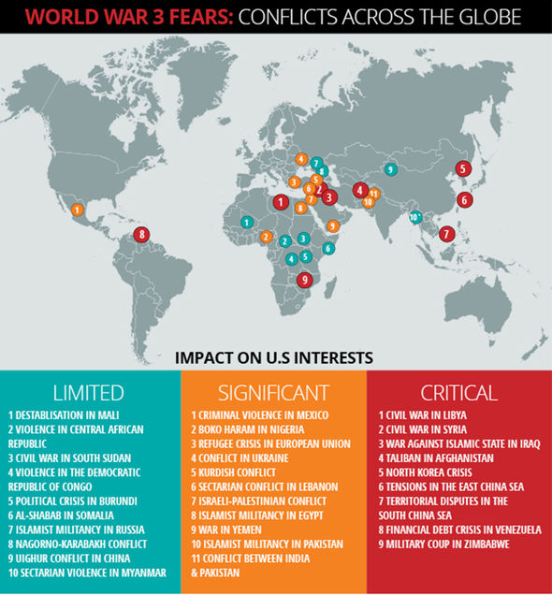
Conflicts in the world

Slide 5
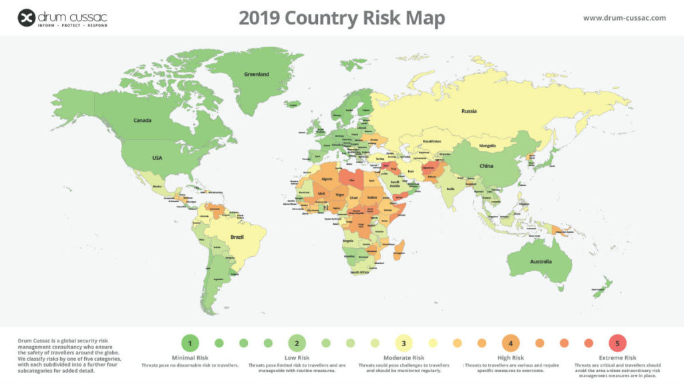
Countries at risk of conflict
Notes:
https://drum-cussac.com/blog/world-risk-map/

Slide 6
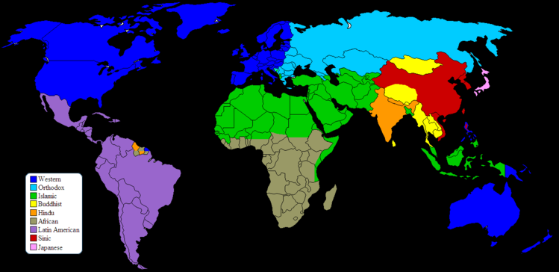
Clash of Civilizations. Huntington
Notes:
https://en.wikipedia.org/wiki/Clash_of_Civilizations

Slide 7
Global Conflict Tracker
Center for Foreign Relations US based think tank runs this website . https://www.cfr.org/interactive/global-conflict-tracker/?category=us

Slide 8
International Conflict
Traditionally, the term "international conflict" referred to conflicts between different nation-states and conflicts between people and organizations in different nation-states. Increasingly, however, it also applies to inter-group conflicts within one country when one group is fighting for independence or increased social, political, or economic power (e.g., Sudan/South Sudan, Iraq (now that the US has largely left), and Syria.-Cate Malek , Heidi Burgess
Notes:
https://www.beyondintractability.org/coreknowledge/international-conflict

Slide 9
Private And Public International Conflicts
private-sector international conflicts, are conflicts between individuals and/or businesses which just happen to come from two different countries.
Public international conflicts are conflicts between different national governments .
In the past two three decades an increasing number "international" conflicts have actually been inter-group or communal conflicts within one country. (Examples are Ireland, Sri Lanka, Bosnia, Kosovo, Rwanda, and Chechnya in addition to the ones listed above, and many others.).

Slide 10
International conflicts -War
There is a moderate to high probability of public international conflicts escalating into wars.
The war which happens within the territorial limits is called Civil War.

Slide 11
International Humanitarian Law
International humanitarian law is a set of rules which seek, for humanitarian reasons, to limit theeffects of armed conflict. It protects persons who are not or are no longer participating in the hostilities and restricts the means and methods of warfare. International humanitarian law is also known as the law of war or the law of armed conflict.
Notes:
https://www.icrc.org/en/doc/assets/files/other/what_is_ihl.pdf

Slide 12
International Humanitarian Law-2
A major part of international humanitarian law is contained in the four Geneva Conventions of 1949. Nearly every State in the world has agreed to be bound by them. The Conventions have been developed and supplemented by two further agreements: the Additional Protocols of 1977 relating to the protection of victims of armed conflicts.
Notes:
https://www.icrc.org/en/doc/assets/files/other/what_is_ihl.pdf

Slide 13
International humectation law -3
the 1954 Convention for the Protection of Cultural Property in the Event of Armed Conflict, plus its two protocols;
the 1972 Biological Weapons Convention;
the 1980 Conventional Weapons Convention and its five protocols;
the 1993 Chemical Weapons Convention; ! the
1997 Ottawa Convention on anti-personnel mines;
the 2000 Optional Protocol to the Convention on the Rights of the Child on the involvement of children in armed conflict.
Notes:
1. https://www.icrc.org/en/doc/assets/files/other/what_is_ihl.pdf
2. https://ijrcenter.org/international-humanitarian-law/

Slide 14
Conflict as Threat to Peace
Conflicts especially when are armed conflicts they affect human life very badly.
Intractable conflicts put regions and people at risk.
Civil wars lead to excessive use of force and militarization of civic life and creates serious chasms.
Un resolved economic disputes bead the nations and create serious problems in global governance of economey .

Slide 15
Peace Negative and Positive
Johan Galtung, the father of peace studies often refers to the distinction between ‘negative peace’ and ‘positive peace’ Negative peace refers to the absence of violence. When, for example, a ceasefire is enacted, a negative peace will ensue
Positive peace is filled with positive content such as restoration of relationships, the creation of social systems that serve the needs of the whole population and the constructive resolution of conflict.
Peace does not mean the total absence of any conflict. It means the absence of violence in all forms and the unfolding of conflict in a constructive way.
Peace therefore exists where people are interacting non-violently and are managing their conflict positively – with respectful attention to the legitimate needs and interest of all concerned.
Notes:
1. http://www.activeforpeace.org/no/fred/Positive_Negative_Peace.pdf
2. http://www.irenees.net/bdf_fiche-notions-186_en.html

Slide 16
Conflict Resolution and Use of Force
This is in simple terms what is WAR all about.
What is the probability of resolving conflicts with use of force?

Slide 17
The Limits of Force in Settling Conflicts
Force cannot solve all the conflicts which can threaten peace .
Force has serious limitations in modern day conflicts especially they are inter territorial

Slide 18
Peaceful settlement of disputes
The most important treaties are the 1899 Hague Convention for the Pacific Settlement of International Disputes which was revised by the Second Hague Peace Conference in 1907.(PCA 1899).
1928 General Act for the Pacific Settlement of Disputes which was concluded under the auspices of the League of Nations.
Chapter VI of the Charter. Chapter VI of the Charter contains the United Nations mechanism for the pacific settlement of disputes.

Slide 19
Peaceful settlement of disputes-2
Diplomatic Methods of Dispute Settlement
Negotiation
Enquiry
Mediation
Conciliation
Method of good offices
Notes:
https://www.longdom.org/articles/peaceful-settlement-of-disputes.pdf

Slide 20
Peaceful settlement of Disputes-3
Adjudicative Methods of Dispute Settlement.
Arbitration.(PCA)
Judicial settlement ( ICJ ,ITLOS)
. Institutional Methods of Dispute Settlement.
By United Nations
Regional Orgnisations

Slide 21
Points to Ponder
How should we understand the concept of peace and security?
What is a international Conflict? And what are the ways to deal with conflicts?
What is the effectiveness use of force amounting to war to solve the conflicts?
What are the methods of peaceful settlement of disputes.

